Slide 1


Sanjana Hemdev
12/28/2024

Slide 2

Outline
Executive Summary
Introduction
Methodology
Results
Conclusion
Appendix

Slide 3
Executive Summary
Summary of methodologies
Data collection
Data wrangling
Exploratory Data Analysis with data visualization
Exploratory Data Analysis with SQL
Building an interactive map with Folium
Building an interactive dashboard with Dash
Predictive analysis
Summary of all results
Exploratory Data Analysis results
Interactive analytics screenshots
Predictive analysis results

Slide 4
Introduction
Project background and context
SpaceX is the most successful company of the commercial space age, making space travel affordable. The company advertises Falcon 9 rocket launches on its website, with a cost of $62mil; other providers cost upwards of $165mil each. Much of the savings is because SpaceX can reuse the first stage. Therefore, if we can determine if the first stage will land, we can determine the cost of a launch. Based on public information and machine learning models, we are going to predict of SpaceX will reuse the first stage.
Problems you want to find answers
How do variables such as payload madd, launch site, number of flights and orbits affect the success of the first stage landing?
Does the rate of successful landings increase over the years?
What is the best algorithm that can be used for binary classification in this case?

Slide 5

Section 1

Slide 6
Methodology
Executive Summary
Data collection methodology:
Using SpaceX REST API
Using Webscraping of Wikipedia (BeautifulSoup)
Perform data wrangling
Data filtration
Dealing with missing values
Using One Hot encoding to prepare the data to a binary classification
Perform exploratory data analysis (EDA) using visualization and SQL
Perform interactive visual analytics using Folium and Plotly Dash
Perform predictive analysis using classification models
Building, tuning and comparative evaluation of classification models using the Scikit-learn Python library to ensure the best results

Slide 7
Data Collection
The data collection process involved a combination of API requests from the SpaceX REST Api and webscraping of data from a table in SpaceX’s Wikipedia entry.
We had to use both of these data collection methods in order to get complete information about the launches for a more detailed analysis.
Data Columns obtained by using SpaceX REST API:
FlightNumber, Date, BoosterVersion, PayloadMass, Orbit, LaunchSite, Outcome, Flights, GridFins, Reused, Legs, LandingPad, Block, ReusedCount, Serial, Longitude, Latitude
Data Columns obtained by using Webscraping:
Flight No., Launch site, Payload, PayloadMass, Orbit, Customer, Launch outcome, Version Booster, Booster landing, Date, Time

Slide 8
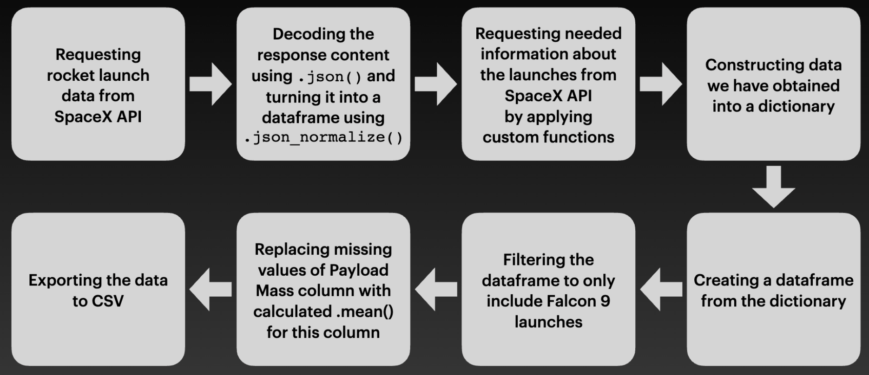
Data Collection – SpaceX API
Link to GitHub: Data Collection using API

Slide 9
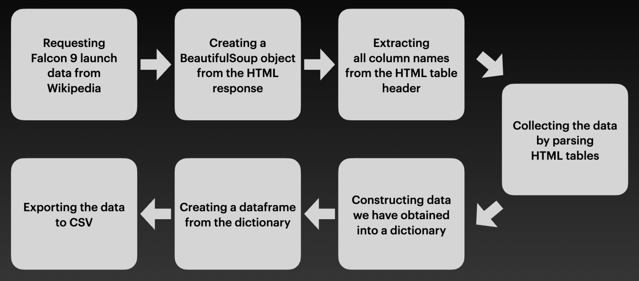
Data Collection - Scraping
Link to GitHub: Data Collection using Webscraping

Slide 10
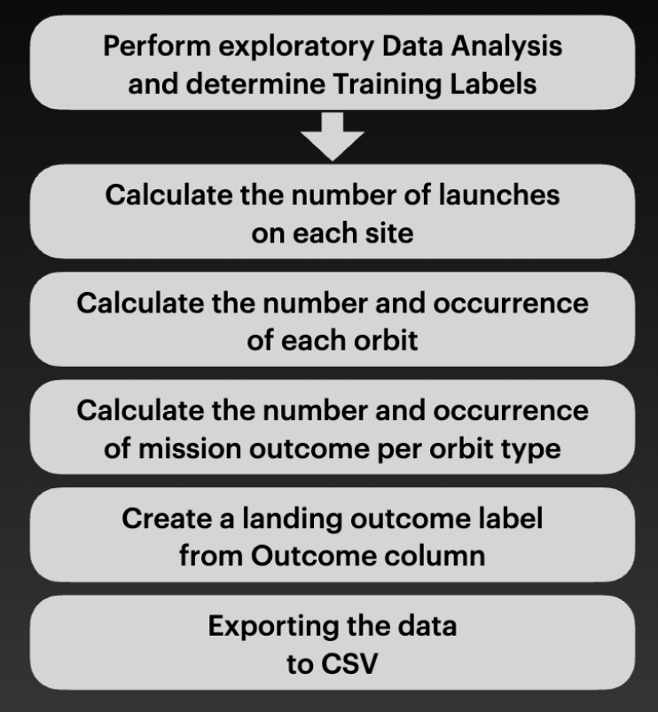
Data Wrangling
In the dataset, there are several different cases where the booster did not land successfully. Sometimes, a landing was attempted but failed due to an accident; for example, True Ocean means the mission outcome was successfully landed to a specific region of the ocean. True RTLS means the mission outcome was successfully landed to a ground pad. False RTLS means the mission outcome was unsuccessfully landed to a ground pad. True ASDS means the mission outcome was successfully landed on a drone ship. False ASDS means the mission outcome was unsuccessfully landed on a drone ship.
We mainly convert those outcomes into Training Labels with “1” meaning the booster successfully landed and “0” meaning it was unsuccessful.
Link to GitHub: Data Wrangling

Slide 11
EDA with Data Visualization
Charts plotted:
Flight Number vs. Payload Mass
Flight Number vs. Launch Site
Payload Mass vs. Launch Site
Orbit Type vs. Success Rate
Flight Number vs. Orbit Type
Payload Mass vs. Orbit Type
Success Rate Yearly Trend
Link to GitHub: EDA with Data Visualization

Slide 12
EDA with SQL
SQL queries performed:
Displaying the names of the unique launch sites in the space mission
Displaying 5 records where launch sites begin with the string ‘CCA’
Displaying the total payload mass carried by boosters launched by NASA (CRS)
Displaying average payload mass carried by booster version F9 v1.1
Listing the date when the first successful landing outcome in ground pad was achieved
Listing the names of the boosters which have success in drone ship and have payload mass greater than 4000 but less than 6000
Listing the total number of successful and failure mission outcomes
Listing the names of the booster versions which have carried the maximum payload mass
Listing the failed landing outcomes in drone ship, their booster versions and launch site names for the months in year 2015
Ranking the count of landing outcomes (such as Failure (drone ship) or Success (ground pad)) between the date 2010-06-04 and 2017-03-20 in descending order
Link to GitHub: EDA with SQL

Slide 13
Build an Interactive Map with Folium
Markers of all Launch Sites:
Added Marker with Circle, Popup Label and Text Label of NASA Johnson Space Center using latitude and longitude coordinates as a start location.
Added Markers with Circle, Popup Label and Text Label of all Launch Sites using their latitude and longitude coordinates to show their geographical locations and proximity to Equator and coasts.
Colored Markers of the launch outcomes for each Launch Site:
Added colored Markers of success (Green) and failed (Red) launches using Marker Cluster to identify which launch sites have relatively high success rates.
Distances between a Launch Site to its proximities:
Added colored Lines to show distances between the Launch Site KSC LC-39A (as an example) and its proximities like Railway, Highway, Coastline and Closest City.
Link to GitHub: Interactive Visual Analytics with Folium

Slide 14
Build a Dashboard with Plotly Dash
Launch Sites Dropdown List:
Added a dropdown list to enable Launch Site selection.
Pie Chart showing Success Launches (All Sites/Certain Site):
Added a pie chart to show the total successful launches count for all sites and the Success vs. Failed counts for the site, if a specific Launch Site was selected.
Slider of Payload Mass Range:
Added a slider to select Payload range.
Scatter Chart of Payload Mass vs. Success Rate for the different Booster Versions:
Added a scatter chart to show the correlation between Payload and launch Success.
Link to GitHub: SpaceX Dash App

Slide 15
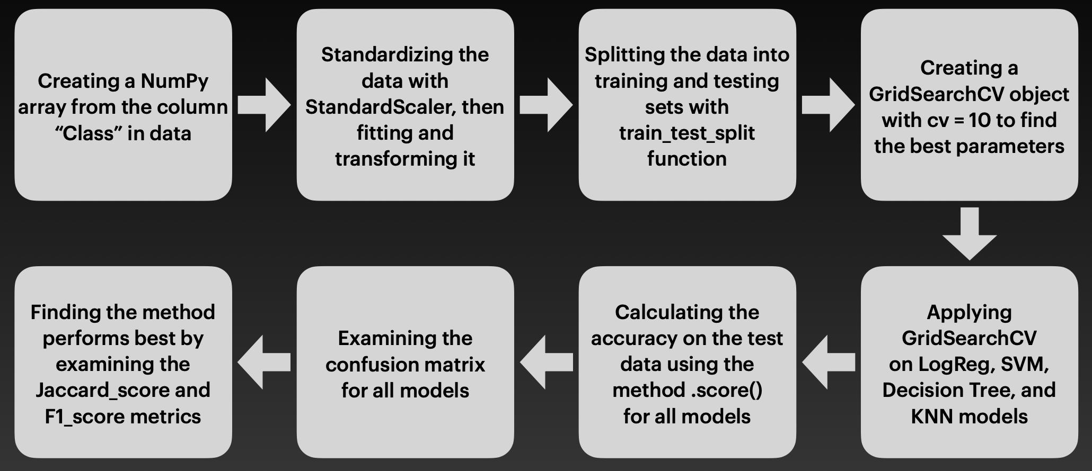
Predictive Analysis (Classification)
Link to GitHub: Machine Learning Prediction

Slide 16
Results
Exploratory data analysis results
Interactive analytics demo in screenshots
Predictive analysis results

Slide 17

Section 2

Slide 18
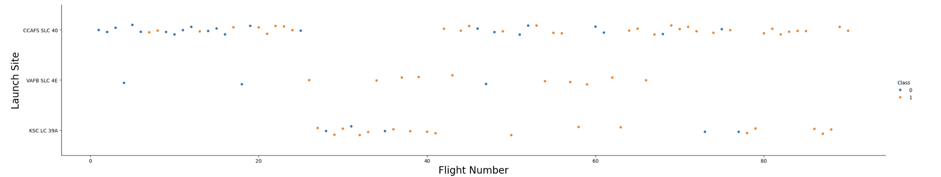
Flight Number vs. Launch Site
Explanation:
The CCAFS SLC 40 launch site has about half of all the launches.
VAFB SLC 4E and KSC LC 39A have higher success rates.

Slide 19
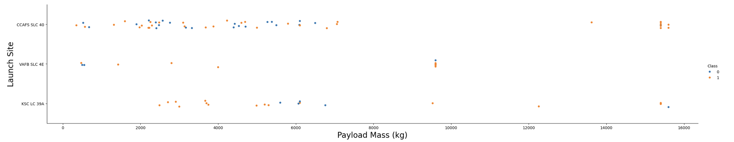
Payload vs. Launch Site
Explanation:
For each launch site, the higher the payload mass, the higher the success rate.
Most of the launches with payload mass over 7000 kg were successful.
KSC LC 39A has a 100% success rate for payload mass under 5500 kg.

Slide 20
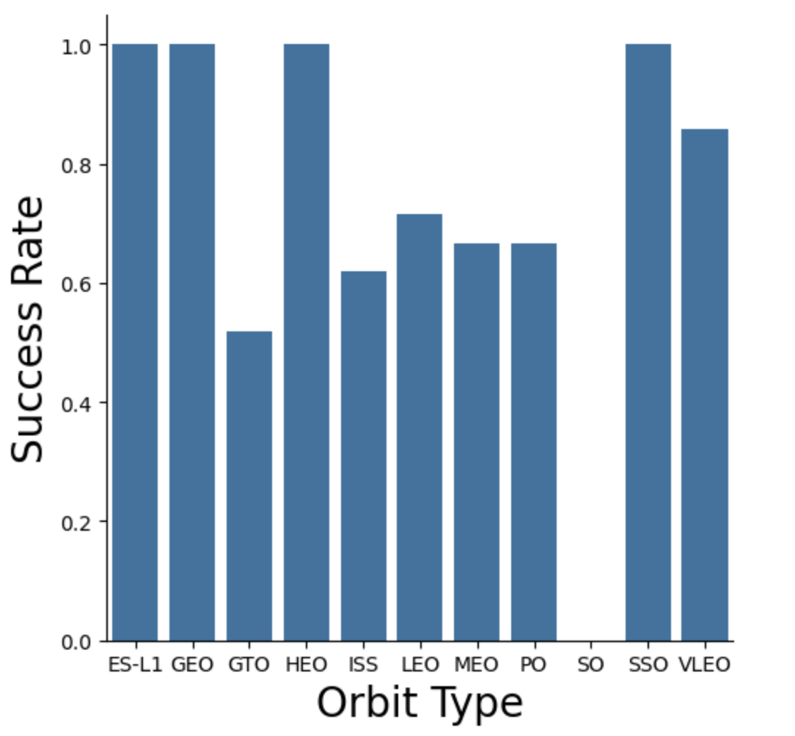
Success Rate vs. Orbit Type
Explanation:
Orbits with 100% success rate:
ES-L1, GEO, HEO, SSO
Orbits with 0% success rate:
SO
Orbits with success rate between 50% and 85%:
GTO, ISS, LEO, MEO, PO

Slide 21
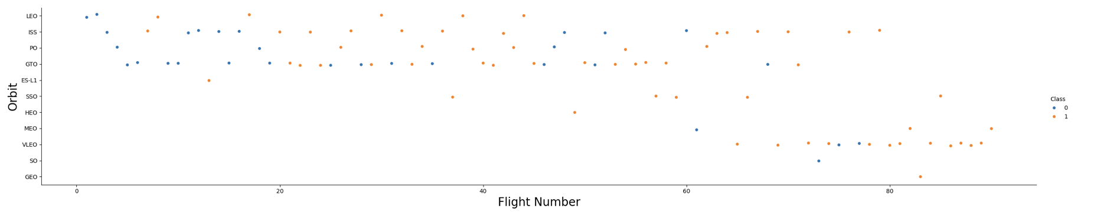
Flight Number vs. Orbit Type
Explanation:
In the LEO orbit, the Success appears related to the number of flights; on the other hand, there seems o be no relationship between flight number when in GTO orbit.

Slide 22
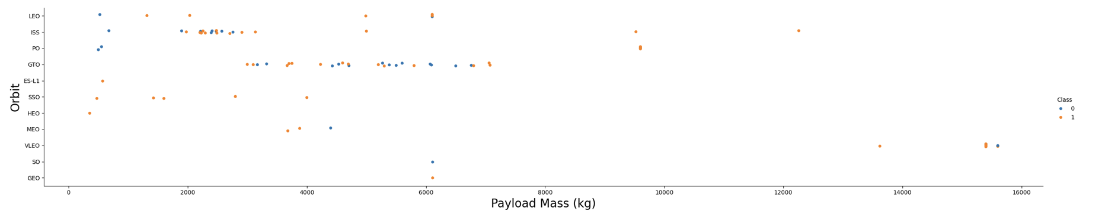
Payload vs. Orbit Type
Explanation:
Heavy payloads have a negative influence on GTO orbits and positive on GTO and Polar LEO (ISS) orbits.

Slide 23
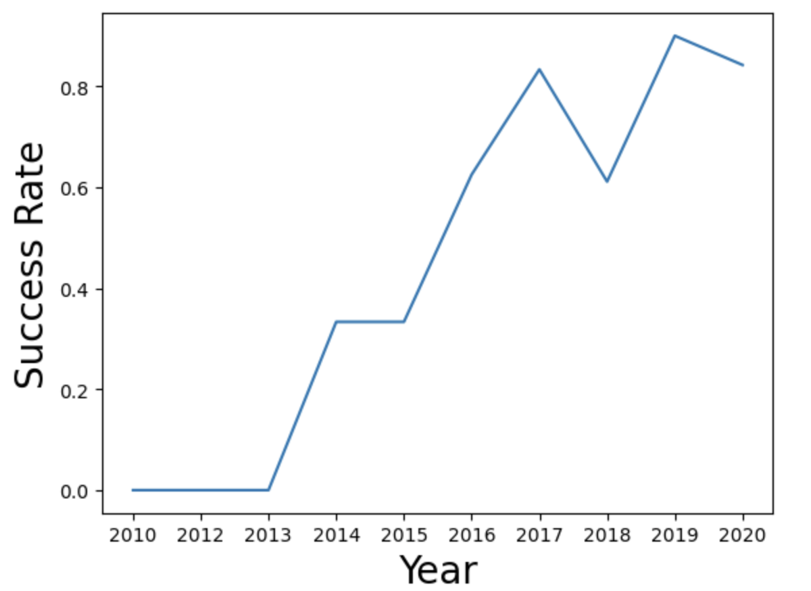
Launch Success Yearly Trend
Explanation:
The success rate since 2013 kept increasing until a dip in 2018.
The success rate increased again in 2019.

Slide 24
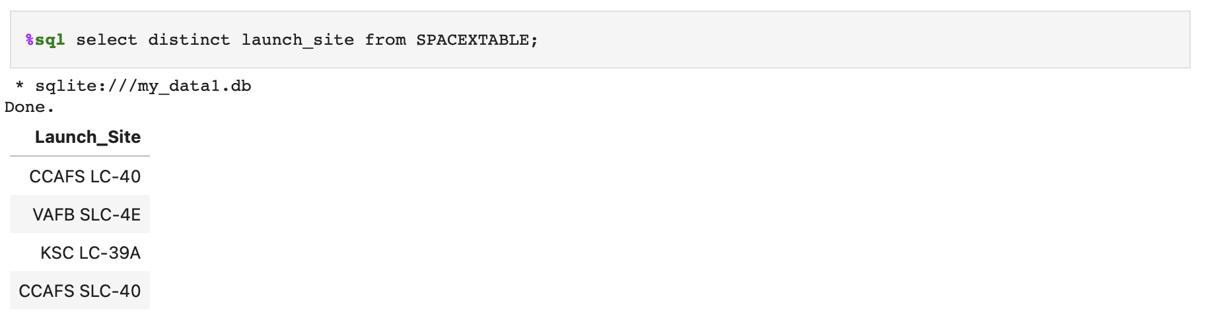
All Launch Site Names
Displaying the names of the unique launch sites in the space mission:

Slide 25
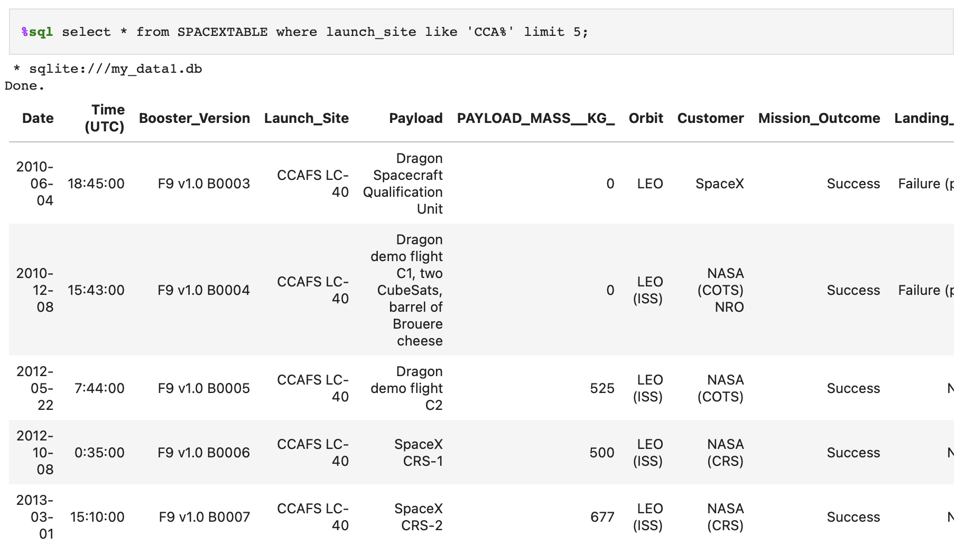
Launch Site Names Begin with 'CCA'
Displaying 5 records where launch sites begin with the string ‘CCA’:

Slide 26
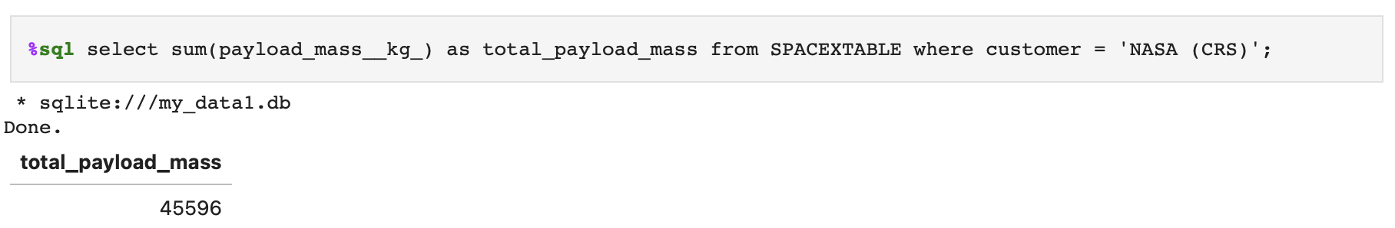
Total Payload Mass
Displaying the total payload mass carried by boosters launched by NASA (CRS):

Slide 27
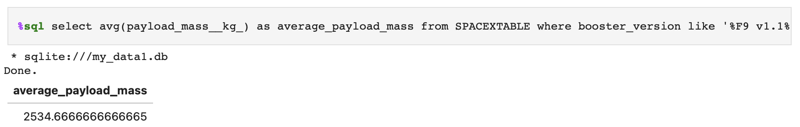
Average Payload Mass by F9 v1.1
Displaying average payload mass carried by booster version F9 v1.1:

Slide 28
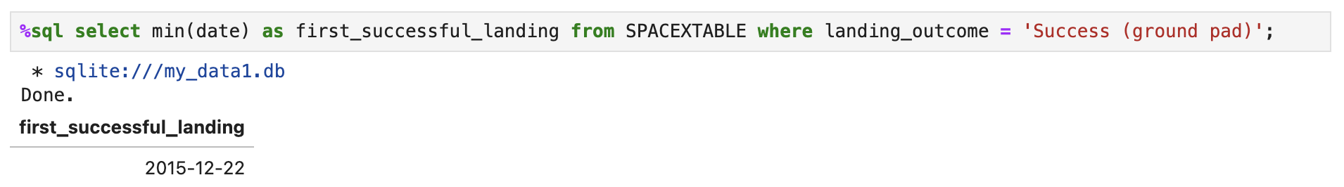
First Successful Ground Landing Date
Listing the date when the first successful landing outcome in ground pad was achieved:

Slide 29
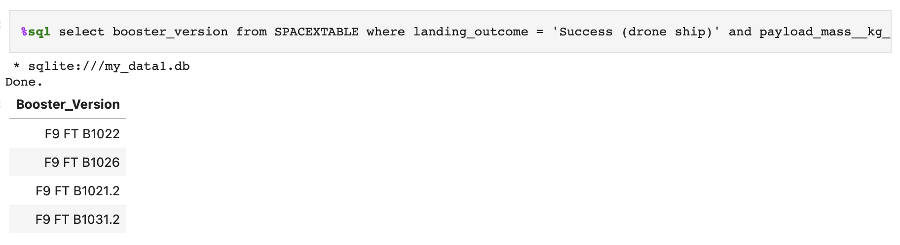
Successful Drone Ship Landing with Payload between 4000 and 6000
Listing the names of the boosters which have success in drone ship and have payload mass greater than 4000 but less than 6000:

Slide 30
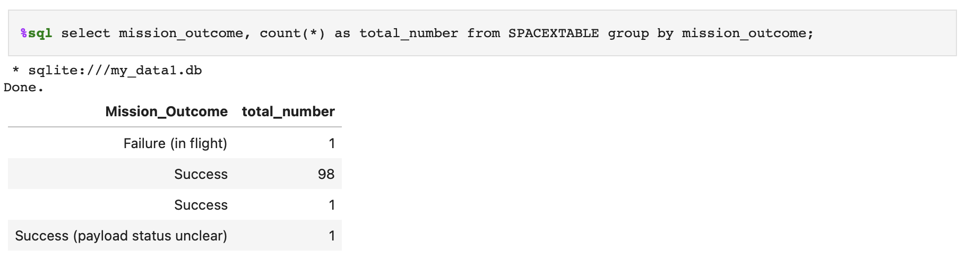
Total Number of Successful and Failure Mission Outcomes
Listing the total number of successful and failure mission outcomes:

Slide 31
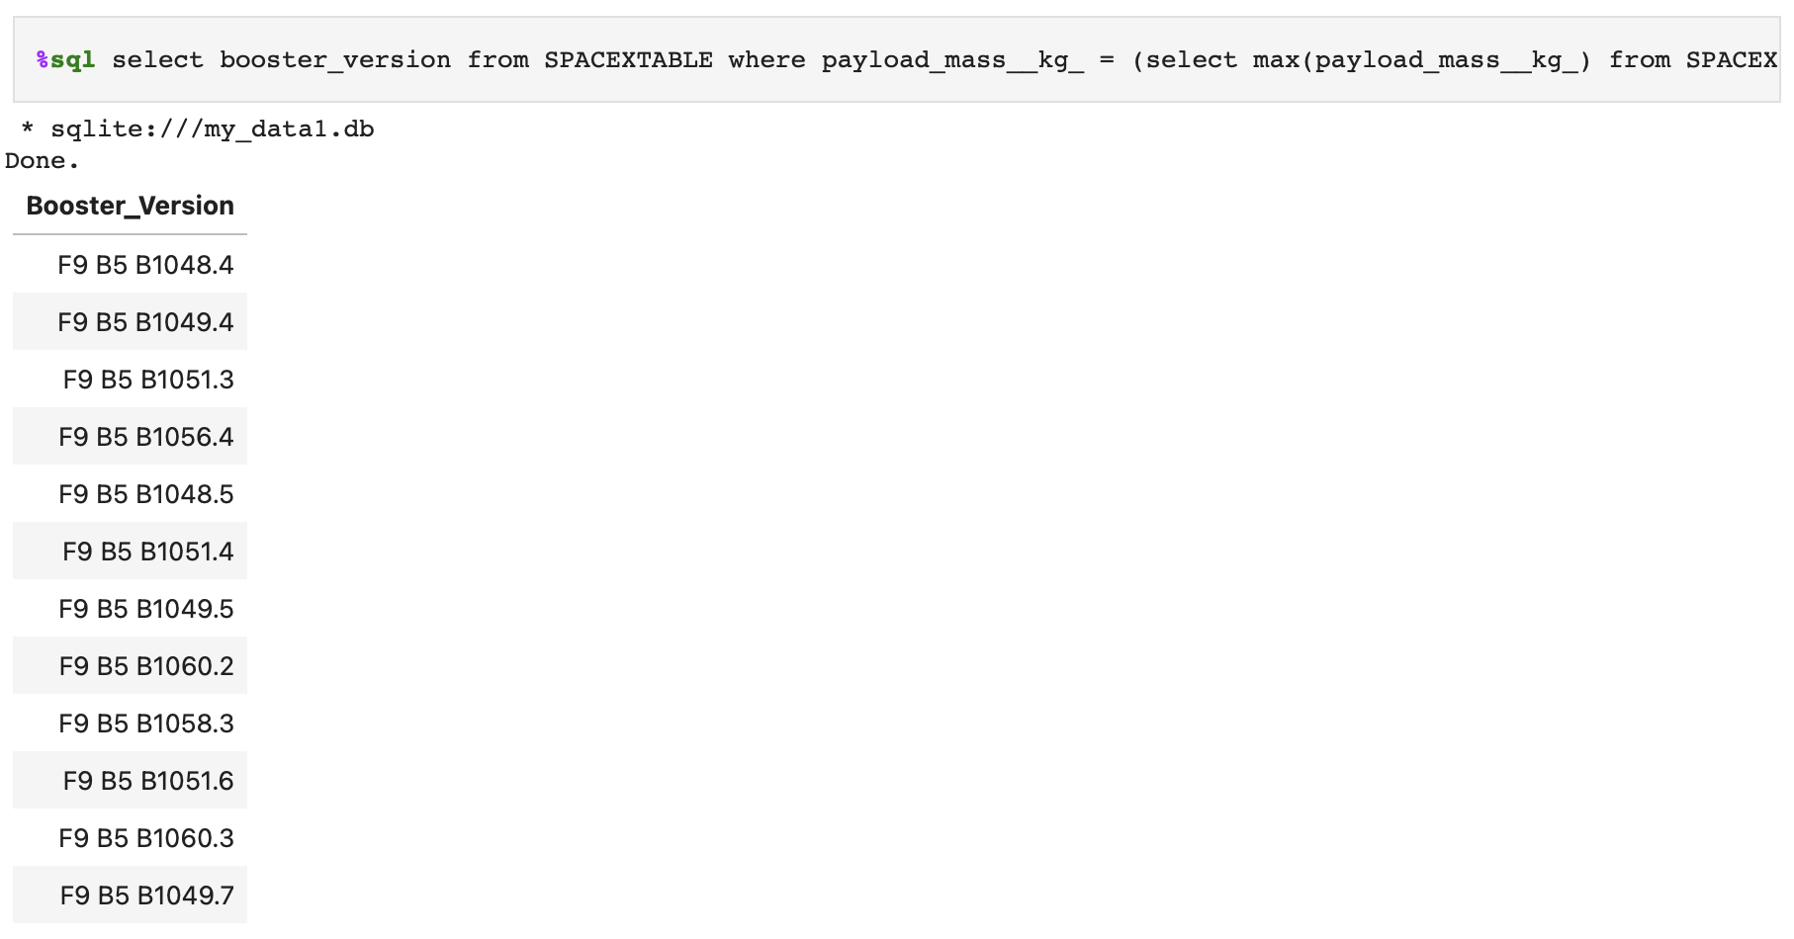
Boosters Carried Maximum Payload
Listing the names of the booster versions which have carried the maximum payload mass:

Slide 32
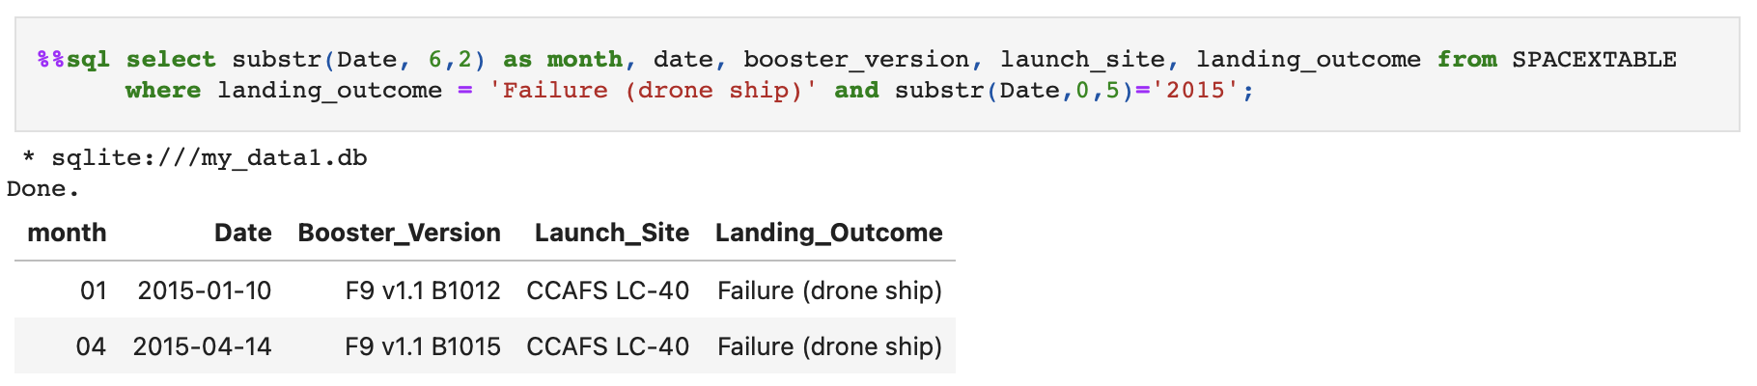
2015 Launch Records
Listing the failed landing outcomes in drone ship, their booster versions and launch site names for the months in year 2015:

Slide 33
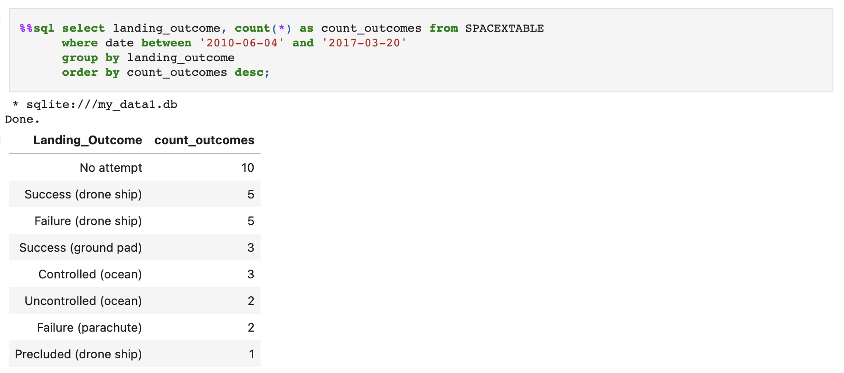
Rank Landing Outcomes Between 2010-06-04 and 2017-03-20
Ranking the count of landing outcomes (such as Failure (drone ship) or Success (ground pad)) between the date 2010-06-04 and 2017-03-20 in descending order:

Slide 34

Section 3

Slide 35
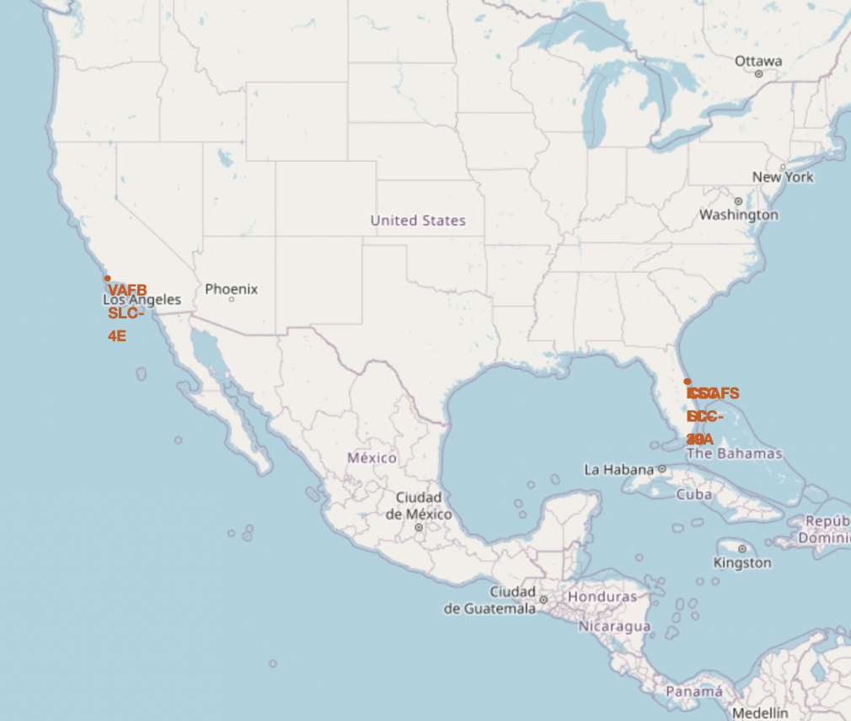
All launch sites’ location markers on a global map
Explanation:
Most of Launch sites are in proximity to the Equator line. The land is moving faster at the equator than any other place on the surface of the Earth. Anything on the surface of the Earth at the equator is already moving at 1670 km/hour. If a ship is launched from the equator, it goes up into space and it is also moving around the Earth at the same speed it was moving before launching. This is because of inertia. This speed will help the spacecraft keep up a good enough speed to stay in orbit.
All launch sites are in very close proximity to the coast, while launching rockets towards the ocean it minimizes the risk of having any debris dropping or exploding near people.

Slide 36
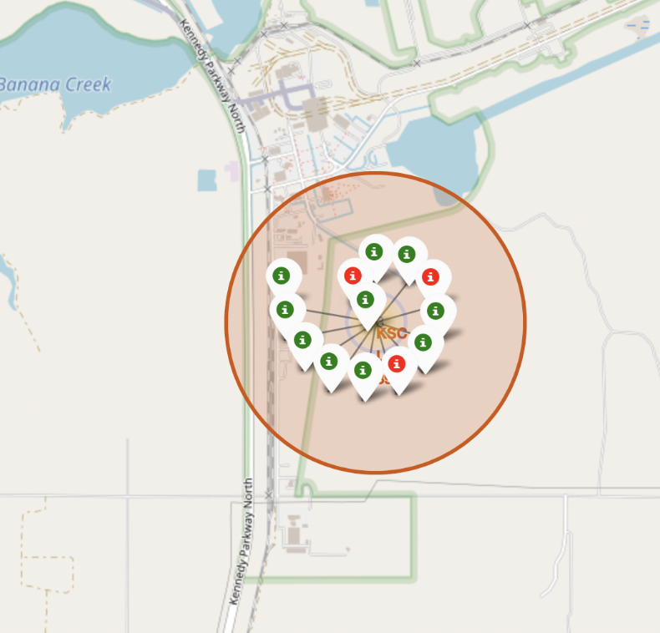
Color-labeled launch records on the map
Explanation:
From the color-labeled markers, we should be able to easily identify which launch sites have relatively high success rates.
Green marker = Successful launch
Red marker = Failed launch
Launch Site KSC LC 39A has a very high Success Rate.

Slide 37
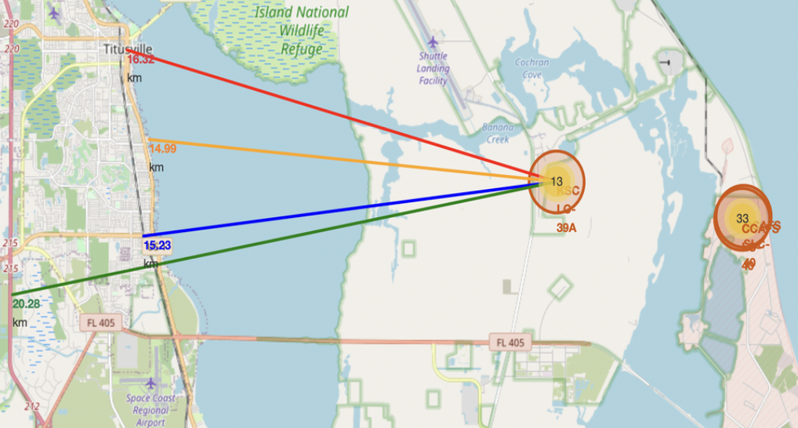
Distance from KSC LC 39A to points of interest
Explanation:
From the visual analysis of the launch site KSC LC 39A, we can clearly see that it is:
Relatively close to railway (15.23 km)
Relatively close to highway (20.28 km)
Relatively close to coastline (14.99 km)
Also the launch site KSC LC 39A is relatively close to its closest city Titusville (16.32 km).
Failed rocket with its high speed can cover distances like 15-20 km in few seconds. It could be potentially dangerous to populated areas.

Slide 38

Section 4

Slide 39
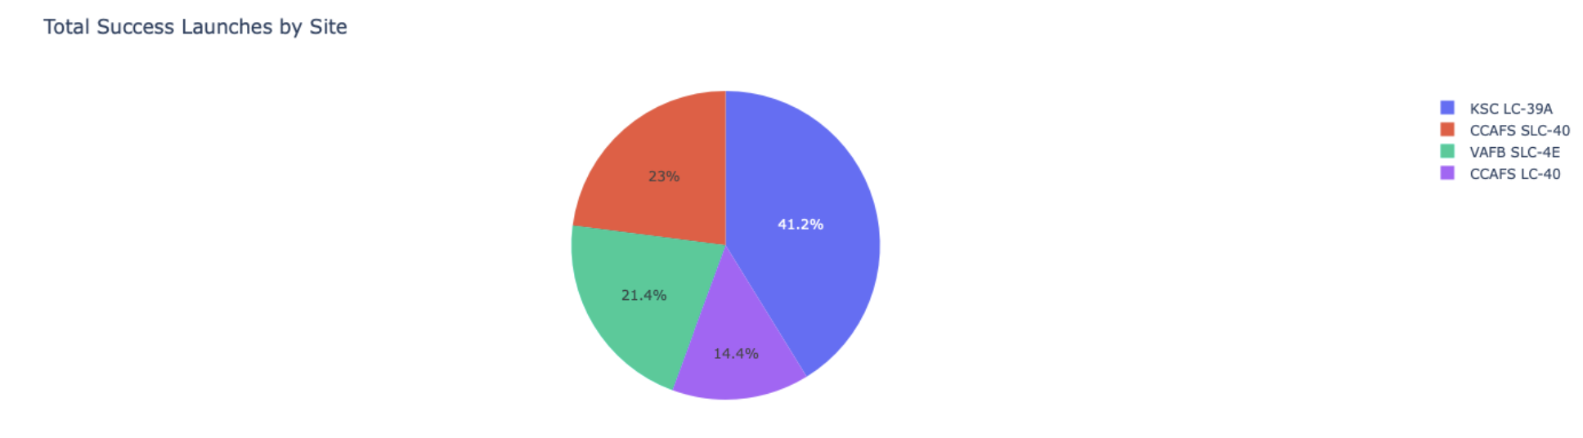
Launch success count for all sites
Explanation:
The chart clearly shows that of all the sites, KSC LC 39A has the most successful launches.

Slide 40
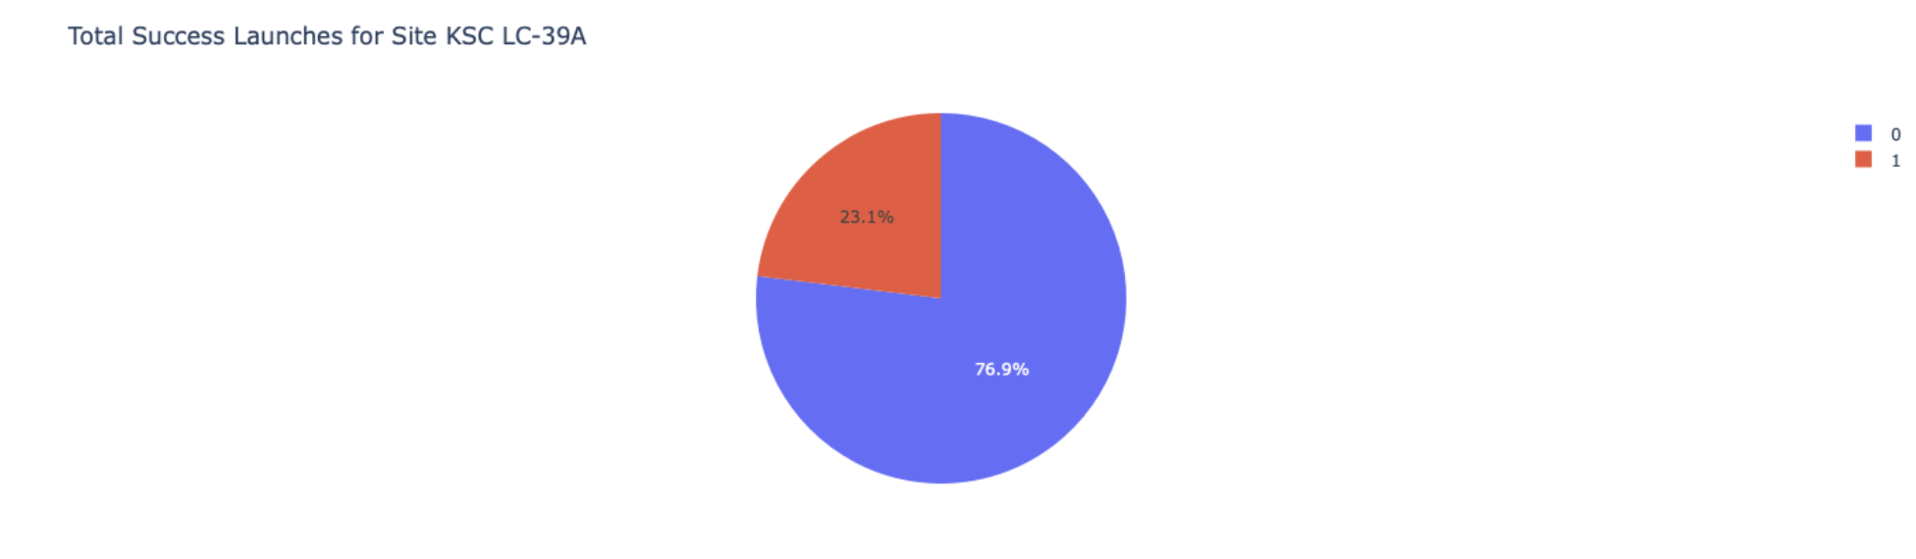
Launch site with highest launch success ratio
Explanation:
KSC LC 39A has the highest launch success rate (76.9%) with 10 successful and only 3 failed landings.

Slide 41
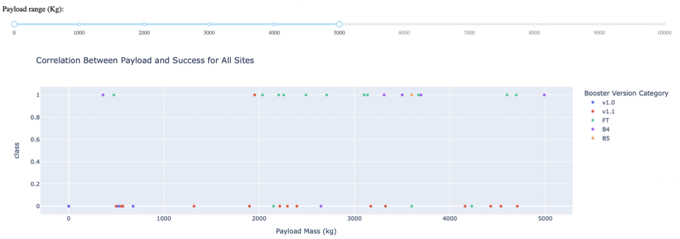
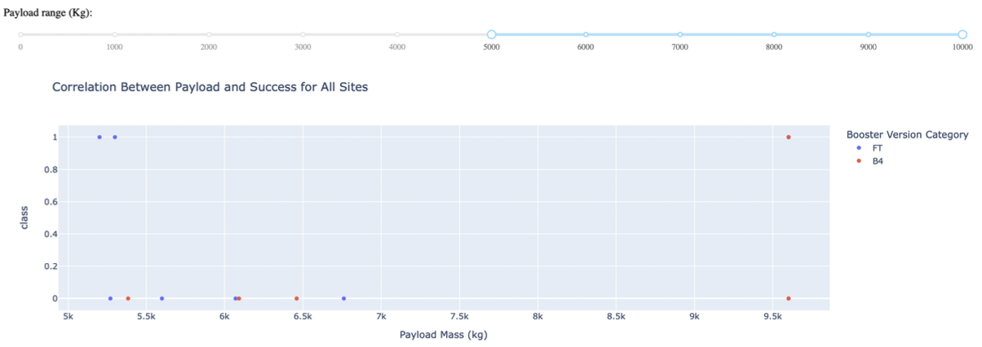
Payload Mass vs. Launch Outcome for all sites
Explanation:
The charts show that payloads between 2000 and 5500 kg have the highest success rate.

Slide 42

Section 5

Slide 43
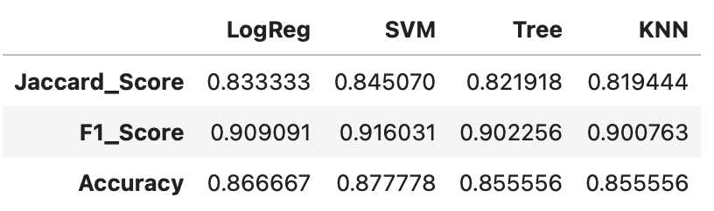
Classification Accuracy
Explanation:
Based on the scores of the Test Set, we can not confirm which method performs best.
Same Test Set scores may be due to the small test sample size (18 samples). Therefore, we tested all methods based on the whole Dataset.
The scores of the whole Dataset confirm that the best model is the Decision Tree Model. This model has not only higher scores, but also the highest accuracy.

Slide 44
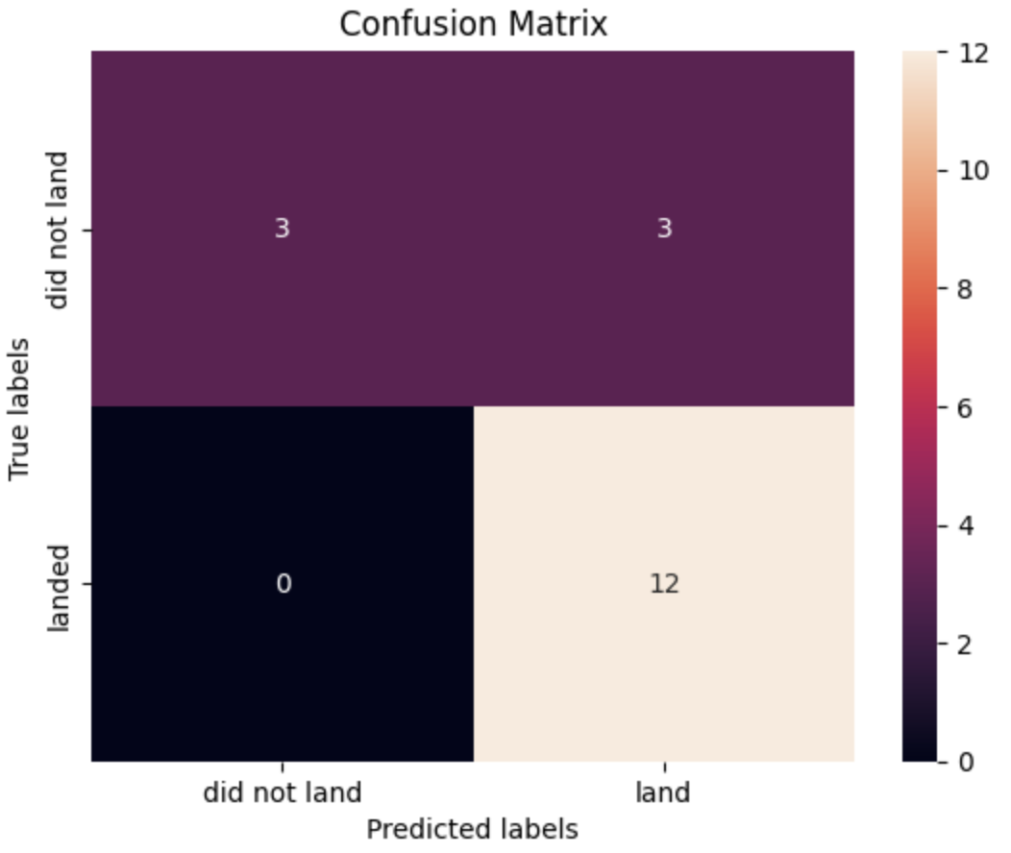
Confusion Matrix
Examining the confusion matrix, we see that logistic regression can distinguish between the different classes. We see that the major problem is false positives.

Slide 45
Conclusions
Decision Tree Model is the best algorithm for this dataset.
Launches with a low payload mass show better results than launches with a larger payload mass.
Most of the launch sites are in proximity to the Equator line and all the sites are in very close proximity to the coast.
The success rate of launches increases over the years.
KSC LC 39A has the highest success rate of the launches from all the sites.
Orbits ES-L1, GEO, HEO and SSO have a 100% success rate.

Slide 46
Appendix
www.w3schools.com
Dash documentation
Python documentation

Slide 47


